Slide 1


Online Intercity Car Pooling System
"Solving Transportation Challenges Together With DataBase"
TEAM MEMBERS :
SACHIN PATIL (PRN : 230943020067)
VEDANT MULHERKAR (PRN : 230943020111)
PRAVESH SINGH (PRN : 230943020075)
FARAZ KHAN (PRN : 230943020029)

Slide 2
INTRODUCTION :
What is car pooling system?
Carpooling is a transportation arrangement where multiple individuals share a single vehicle to travel together, typically to and from work or other common destinations. In carpooling, participants take turns driving or share the cost of transportation, contributing to a more efficient use of vehicles and resources.
Problem Statement
Create an efficient relational database for carpooling system?
Growing demand for car-sharing services.
Huge market for car sharing application.
Need robust and efficient database.
Data generated in real-time during ridesharing activities.
Our schema is tailored to ensure seamless data management, retrieval, and overall system efficiency.

Slide 3
Core Concepts Utilized:
1. Creation of tables in database:
We implemented Create operations to manage the start the lifecycle of databse by creating tables such as passengers, drivers, vehicles, trips, bookings, and feedback.
2.SQL Constraints:
Utilizing SQL constraints, we enforced data integrity by ensuring that only valid and consistent data is stored in the database. This includes primary keys, unique constraints, and check constraints.
3. Joins and Subqueries:
Employing various types of joins and subqueries, we established meaningful relationships between entities. This facilitates complex queries and efficient retrieval of data from multiple tables.
4.Case Statements:
Case statements were employed to perform conditional logic within SQL queries, enhancing the flexibility of data retrieval and presentation based on specific conditions.

Slide 4
5.Keys:
Leveraging primary keys and foreign keys, we established relationships between tables, ensuring referential integrity and providing a foundation for efficient data retrieval.
6. PL SQL Concepts:
I. Triggers:
Triggers were implemented to automatically respond to specific events, allowing for the enforcement of business rules and data consistency.
II. Stored Procedures:
Procedures were created to encapsulate sequences of SQL statements, promoting code modularity and reusability.
III. Stored Functions:
Functions were employed to perform specific computations, enhancing the extensibility and maintainability of the system.
IV. Views:
Views were utilized to abstract complex queries into virtual tables, simplifying the interaction with the database for end-users.

Slide 5
System Components:
Passenger, Driver, and Vehicle Management:
Detailed information about passengers, drivers, and their respective vehicles is stored, allowing for efficient tracking and management of user data.
Trip and Booking Management:
Trips, including departure, destination, time, and available seats, are organized. Bookings are managed to track passenger reservations and associated details.
Feedback System:
A comprehensive feedback system captures passenger ratings, comments, and driver feedback. This enhances the overall user experience and allows for continuous improvement.
Billing Procedures:
A stored procedure for billing has been implemented, generating detailed bills based on trip and booking information. This ensures transparent and accurate financial transactions.

Slide 6
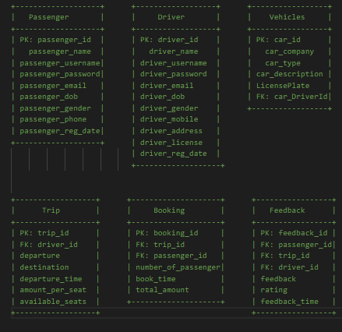
Tables

Slide 7
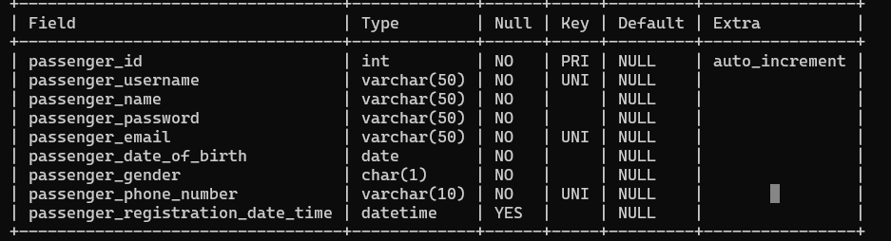
Table Description
Passenger Table
CREATE TABLE Passenger(
passenger_id INT AUTO_INCREMENT PRIMARY KEY, passenger_username VARCHAR(50) NOT NULL UNIQUE, passenger_name VARCHAR(50) NOT NULL, passenger_password VARCHAR(50) NOT NULL, passenger_email VARCHAR(50) NOT NULL UNIQUE, passenger_date_of_birth DATE NOT NULL, passenger_gender CHAR(1) NOT NULL, passenger_phone_number VARCHAR(10) NOT NULL UNIQUE , passenger_registration_date_time datetime);

Slide 8
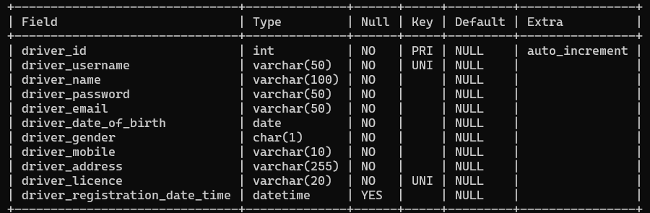
Driver Table
CREATE TABLE Driver (
driver_id INT AUTO_INCREMENT PRIMARY KEY, driver_username VARCHAR(50) NOT NULL UNIQUE, driver_name VARCHAR(100) NOT NULL, driver_password VARCHAR(50) NOT NULL, driver_email VARCHAR(50) NOT NULL, driver_date_of_birth DATE NOT NULL, driver_gender CHAR(1) NOT NULL, driver_mobile VARCHAR(10) NOT NULL, driver_address VARCHAR(255) NOT NULL, driver_licence VARCHAR(20) NOT NULL UNIQUE, driver_registration_date_time datetime );

Slide 9
Vehicle Table
CREATE TABLE Vehicles (
car_id INT AUTO_INCREMENT PRIMARY KEY,car_DriverId INT,car_company VARCHAR(255) NOT NULL, car_type VARCHAR(255) NOT NULL, car_description TEXT,LicensePlate VARCHAR(15),CONSTRAINT fk_car_customer FOREIGN KEY (car_DriverId) REFERENCES Driver(driver_id) on delete set null on update set null);

Slide 10
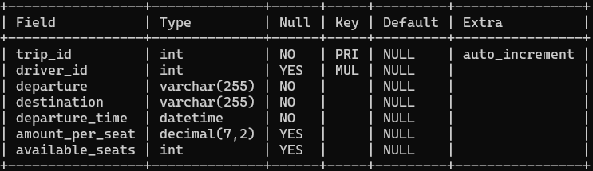
Trip Table
CREATE TABLE Trip (
trip_id INT AUTO_INCREMENT PRIMARY KEY, driver_id INT, departure VARCHAR(255) NOT NULL, destination VARCHAR(255) NOT NULL, departure_time DATETIME NOT NULL, amount_per_seat DECIMAL(7, 2), available_seats INT, CONSTRAINT fk_driver FOREIGN KEY (driver_id) REFERENCES Driver(driver_id) on delete set null on update set null);

Slide 11
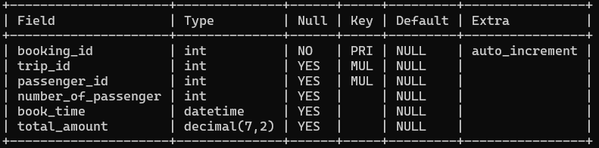
Booking Table
CREATE TABLE Booking (
booking_id INT AUTO_INCREMENT PRIMARY KEY, trip_id INT, passenger_id INT, number_of_passenger INT CHECK(number_of_passenger > 0), book_time datetime, total_amount decimal(7,2), CONSTRAINT fk_trip FOREIGN KEY (trip_id) REFERENCES Trip(trip_id) on delete set null on update set null, CONSTRAINT fk_passenger FOREIGN KEY (passenger_id) REFERENCES Passenger(passenger_id) on delete set null on update set null);

Slide 12
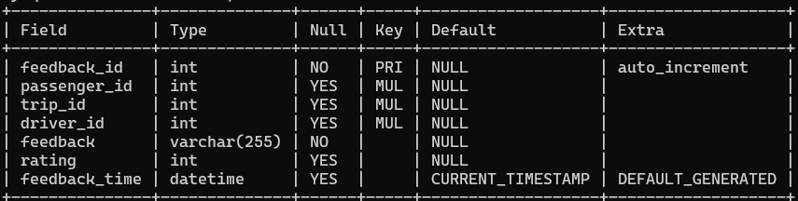
FeedBack Table
CREATE TABLE Feedback (
feedback_id INT PRIMARY KEY AUTO_INCREMENT, passenger_id INT, trip_id INT, driver_id INT, feedback VARCHAR(255) NOT NULL, rating INT CHECK (rating >= 1 AND rating <= 5), feedback_time DATETIME DEFAULT CURRENT_TIMESTAMP, CONSTRAINT fk_passenger_feedback FOREIGN KEY (passenger_id) REFERENCES Passenger(passenger_id) on delete set null on update set null, CONSTRAINT fk_trip_feedback FOREIGN KEY (trip_id) REFERENCES Trip(trip_id) on delete set null on update set null, CONSTRAINT fk_driver_feedback FOREIGN KEY (driver_id) REFERENCES Driver(driver_id) on delete set null on update set null);

Slide 13
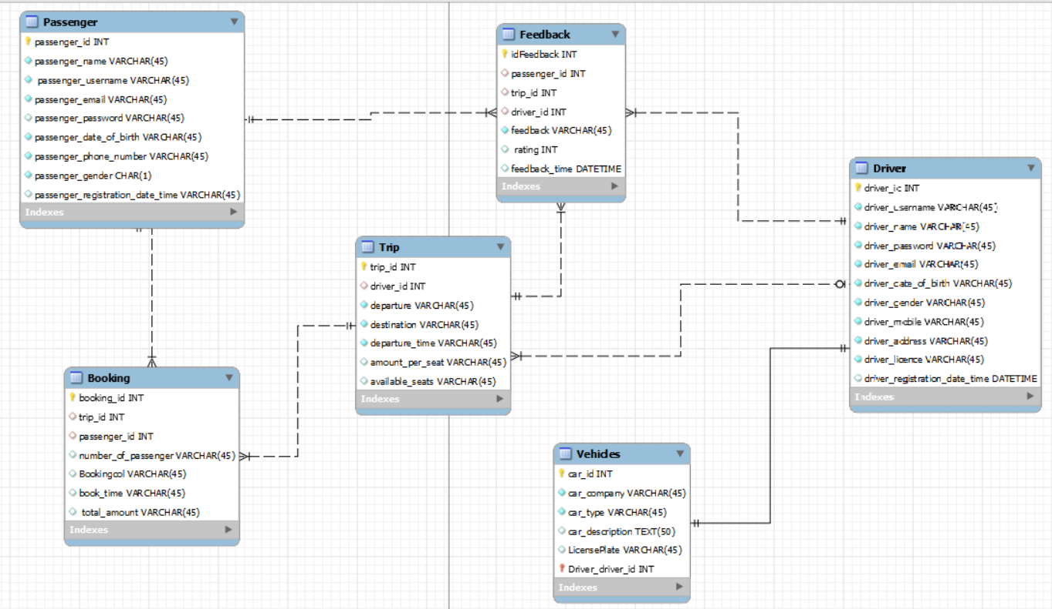
Enhanced Entity-Relationship diagram

Slide 14
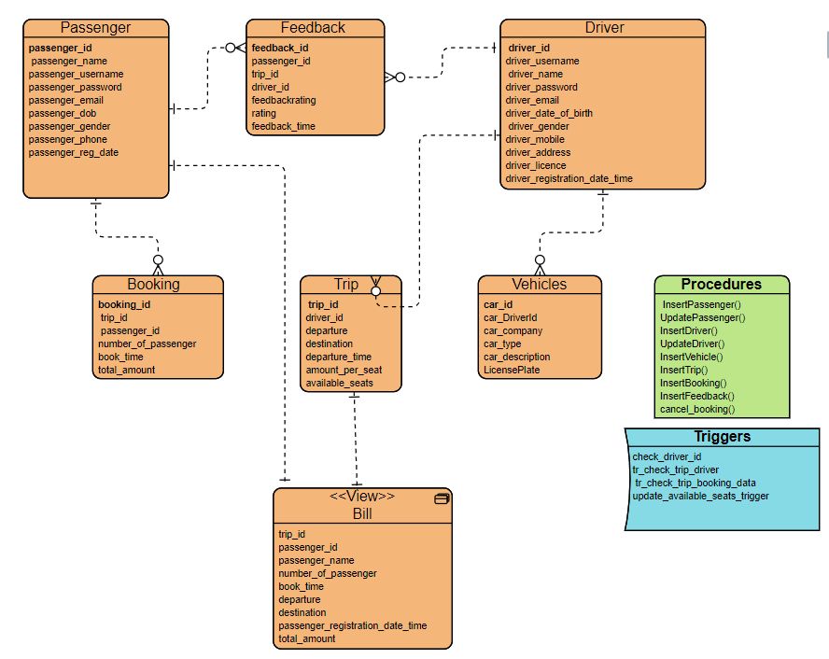
Schema diagram

Slide 15
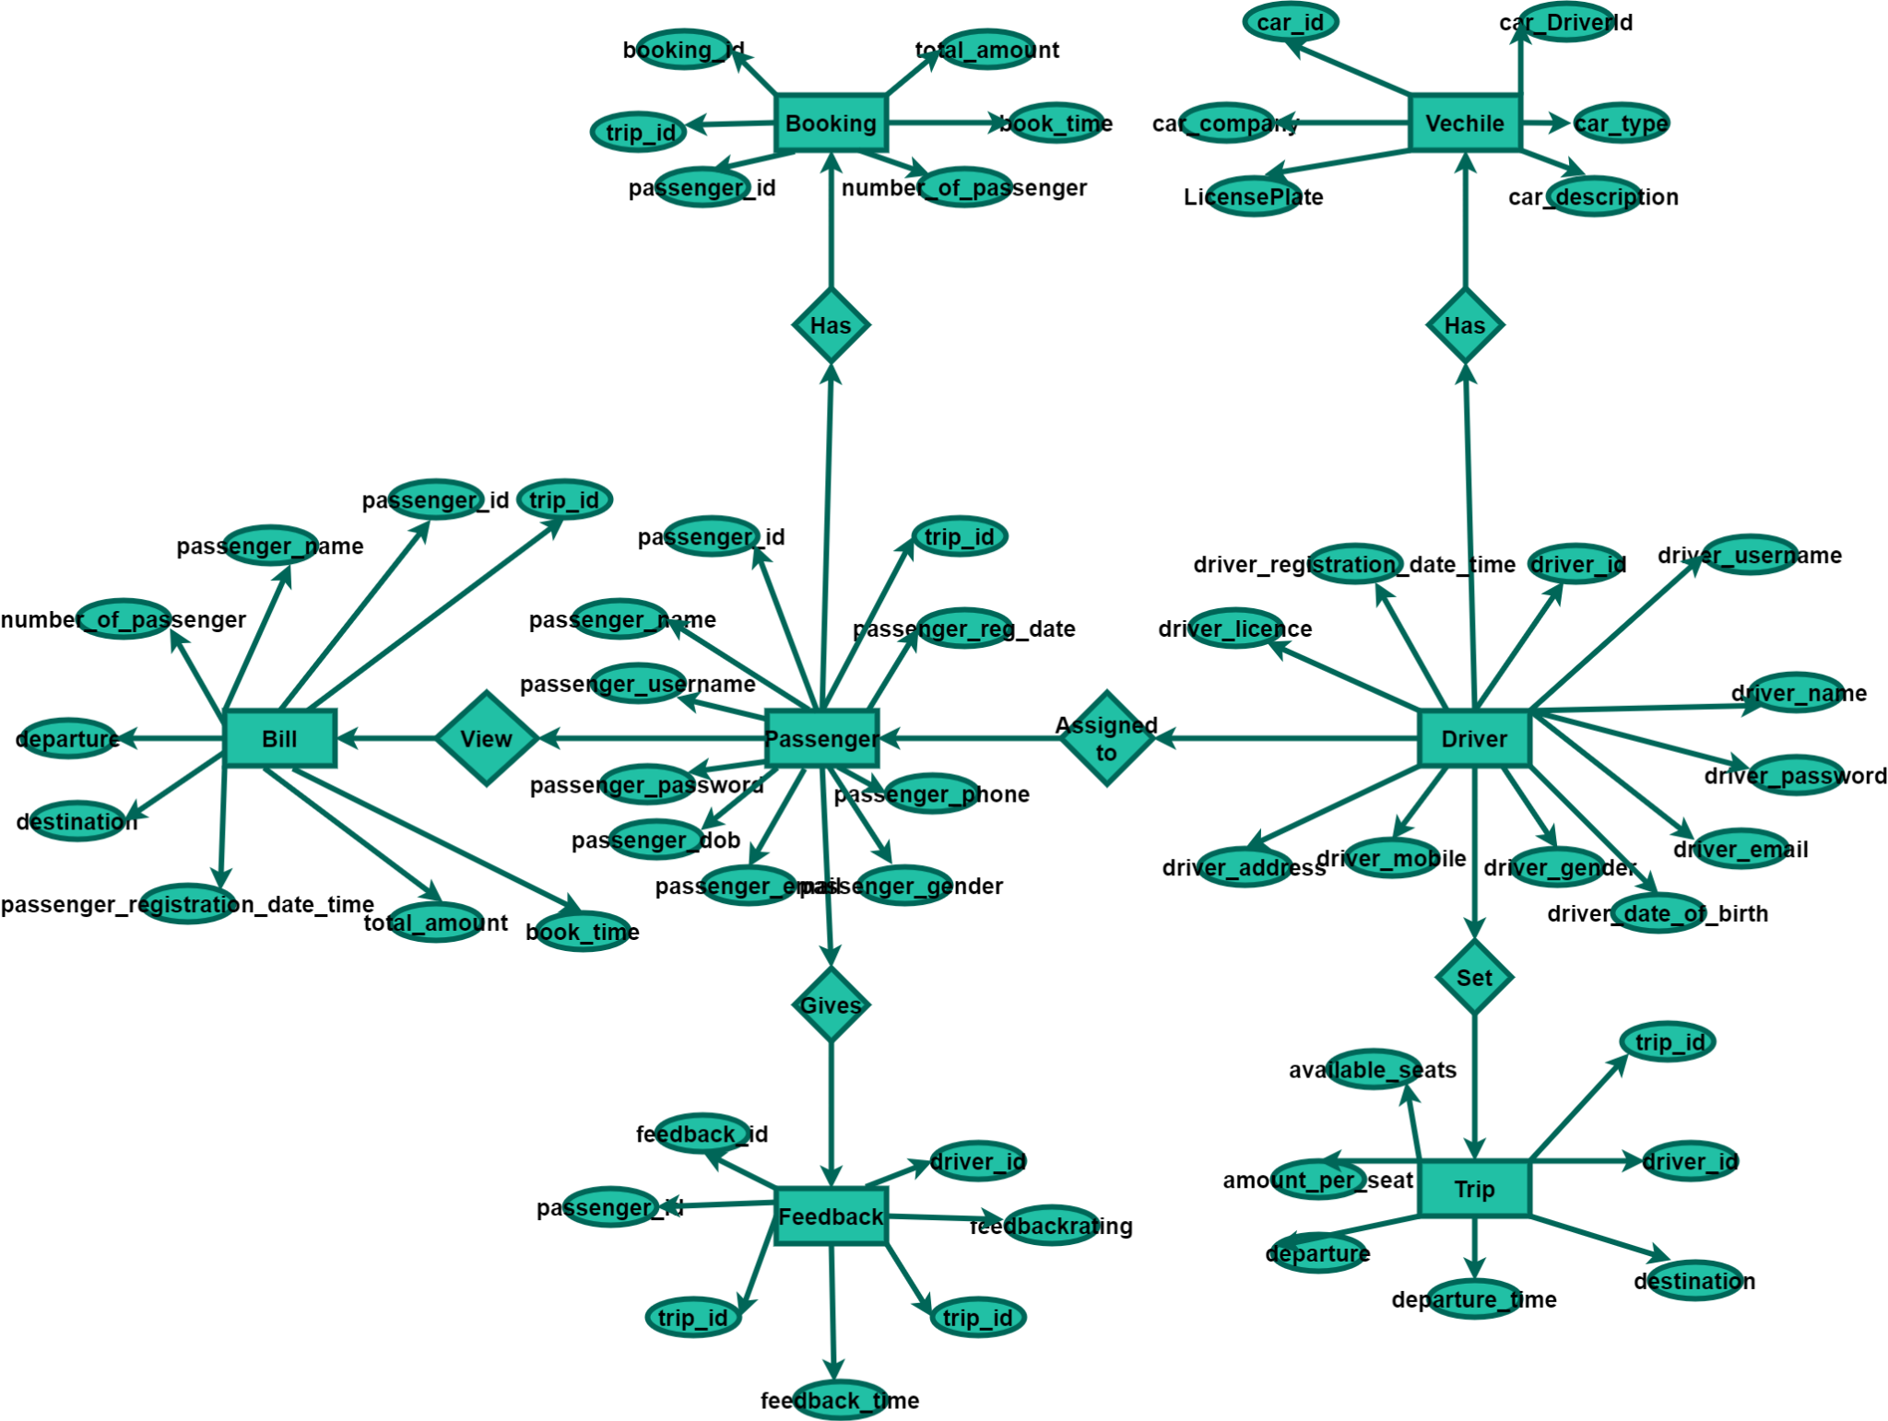
Entity Relationship (ER) Diagram

Slide 16
How It Works
Creation Of Tables
Passenger
Driver
Vehicles
Trip
Booking
Feedback
Insertion Of Data Using Storage Process
We use IN Argument in storage process to insert the data in tables.
Insert passenger
Insert Driver
Insert vehicle
Insert trip
Insert booking
Insert Feedback
Updating Of Data Using Storage Process
We use IN Argument in storage process to insert the data in tables.
Update passenger
Update Driver
Update vehicle
Update trip

Slide 17
Storage Procedure
In SQL, the storage process refers to how data is stored on disk or in memory within a database management system (DBMS).
Storage Process we use for
1. procedure InsertPassenger
This procedure is used to insert data into passenger table.
2. procedure UpdatePassenger
This procedure is used to update data into passenger table.
3. procedure InsertDriver
This procedure is used to insert data into driver table.
4. procedure UpdateDriver
This procedure is used to update driver table.
5. procedure InsertVehicle
This procedure is used to insert data into vehicle table.
6. procedure InsertTrip;
This procedure is used to insert data into trip table.
7. procedure cancel_booking
This procedure is used to cancel booking from booking table using id.
8. procedure InsertFeedback
This procedure is used to insert data into Feedback table.

Slide 18
Storage Function
A stored function is a set of SQL statements that perform some operation and return a single value.
function CalculateTotalAmountForTrip;
This function is used to calculate total amount for trip by passing amount_per_seat and number_of_passenger from passenger table and then Insert into Booking table with calculated total_amount .

Slide 19
Trigger
A trigger is a set of instructions that are automatically executed or fired in response to certain events on a particular table or view in a database.
Triggers are used to enforce business rules, maintain data integrity, and automate actions based on changes to the data.
Types:
1. Before Triggers (BEFORE INSERT, UPDATE, DELETE)
2. After Triggers (AFTER INSERT, UPDATE, DELETE)
Triggers we used
1. check_driver_id
It will call after insert on Vehicles it check driver id of vehicle table and driver id of driver table.
2. tr_check_trip_driver
Trigger call after insert on trip it check driver id of trip table and driver id of driver table.
3. tr_check_trip_booking_data
Trigger for checking before updating into Booking table if trip_id exist and passenger_id exist
4. update_available_seats_trigger
trigger used before deletion into booking table and updatation in trip table according to avaiable_seats which is calculated with available_seats and seats_to_release.

Slide 20
View
A view is a virtual table that is based on the result of a SELECT query. Unlike a physical table, a view does not store the data itself , instead, it is a saved query that can be referenced and queried just like a table
View we used
VIEW bill
We use view to showcase a bill to user which contain certain information like trip_id, passenger_id, passenger_username, number_of_passenger, book_time, departure_time, departure, destination, total_amount it is just like an actual bill.

Slide 21
FUTURE ASPECTS
1. Admin System which will control whole Database.
2. Use of Grant which will give specific permissions.
3. Expansion in current database.
4. More efficient and advance relational connectivity.

Slide 22
CONCLUSION
Our database management schema is a comprehensive solution that not only incorporates fundamental concepts such as CRUD operations, constraints, and keys but also add advanced PL SQL features for enhanced functionality.
The design is geared towards scalability, data integrity, and efficient retrieval, addressing the specific needs of a dynamic and data-intensive carpooling system.
This schema provides a solid foundation for managing the complexities of the car-sharing landscape, contributing to a seamless and reliable user experience.

Slide 23
THANK YOU

